Slide 1
Azure Database for PostgreSQL Top Use Cases

Slide 2

The benefits of Azure Database for PostgreSQL
Build or migrate your workloads with confidence and optimize for value
Highly available and flexible managed database
Migrate to fully managed open source PostgreSQL
Optimize value with a lower total cost of ownership
Simplified developer experience
Advanced data security and compliance
Focus on application innovation with a fully managed, highly available PostgreSQL database, that provides maximum flexibility including zone redundant high availability, custom maintenance windows and AI powered performance optimization
Migrate with ease using a fully managed PostgreSQL databases with support for latest versions. Build with your favorite PostgreSQL extensions and Microsoft’s open-source resources including PostgreSQL extension for Azure Data Studio.
Save up to 62%¹ on a lower total cost of ownership when migrating and modernizing to Azure. Leverage stop/start features, burstable, and reserved instances and only pay for storage when your database is stopped.
Increase productivity with simplified end to end deployment experience. Utilize tight integration with PostgreSQL extensions. Reduce time to market with integration with Azure Kubernetes Service, Azure App Service and more.
Protect your data with enterprise-grade security and compliance, and enhanced security capabilities of Azure Defender and double encryption.
Notes:
¹https://azure.microsoft.com/en-us/resources/analyzing-the-economic-benefit-of-migrating-from-on-premises-instances-to-azure-database-for-postgresql/

Slide 3
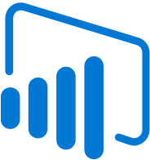




Azure is the best destination for PostgreSQL
Best of open source community along with the manageability and integration benefits of Azure
Open Source
Proven resilience & stability
Rich feature set
Integrated with Azure data ecosystem
Fully managed
Intelligent Performance
Optimize cost
High Availability
Maximum control
Identity, security, management, and compliance

Slide 4


Azure Database for PostgreSQL Top Use Cases
Azure Database for PostgreSQL | Top Use Cases
Thanks! Cloud native section is correct. For migration section, I removed cloud native in slide 5. Also want to add a slide 4 to frame up the 2 main sections of the deck – migration and cloud native.
Flow will be:
Top use cases for Azure DB Postgres can be broken down into 2 main categories – migration and cloud native apps
We’ll start with migration. 2 main migration use cases are homogeneous and oracle to Postgres. Let’s walk through each of these…
Next we’ll talk about cloud native apps – 4 main types that we commonly see – transactional, geospatial, SaaS, and real time. Now I’ll walk you through each of these…
Migration
Cloud-Native Applications

Slide 5


Migration
Cloud-native applications
Migration
Homogeneous Migration
Oracle to Postgres Migration

Slide 6
Homogeneous Migration

Slide 7
Homogeneous migration
Modernize your applications with seamless migration from on-premises PostgreSQL databases to Azure Database for PostgreSQL
Focus on application development, not database management, with fully managed, community edition PostgreSQL
Enjoy high availability with up to 99.99% SLA
Protect your data with advanced security and compliance controls
Accelerate your migration using Azure Database Migration Service
Offline migrations can be done via dump/restore or Azure Data Factory

Slide 8


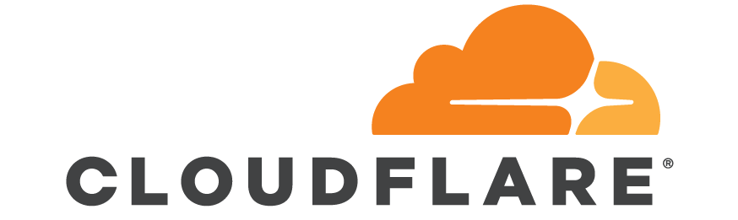

Heroku PostgreSQL Migration to Azure
Startup faced issues with their customer-facing, multi-tenant app on Heroku PostgreSQL (powered by AWS). It was a 3.5 TB database with 0.5 TB RAM and 3 read-replicas.
Some of their customers did not want their data on AWS, costs with their Heroku database were high, and they had performance issues and were hitting a ceiling in terms of infrastructure and scale in Heroku.
They chose Azure Database for PostgreSQL Single Server to reduce costs and improve performance and scalability.
Successfully migrated using a combination of Azure Database Migration Service and a homegrown parallel loader script.
Azure
Azure Database for PostgreSQL
Azure Database for PostgreSQL
Azure Database for PostgreSQL
Azure Database for PostgreSQL
Azure Database for PostgreSQL
Azure Cache for Redis
Azure Cache for Redis
Azure Cache for Redis
Azure Cache for Redis
Azure Cache for Redis
Azure Kubernetes
Services
Azure Kubernetes
Services
Azure Kubernetes
Services
Azure Kubernetes
Services
Azure Kubernetes
Services
Public IP
DNS Zone

Slide 9
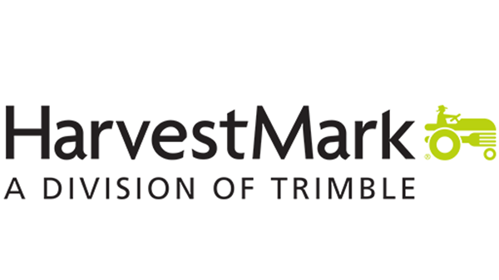
Migration from AWS to Single Server
“We took an instance of the database, copied it to Azure, then spun it up in the Azure managed PostgreSQL environment. It happened flawlessly in two hours.”
– Todd Berg, Head of Product and Customer Success, HarvestMark
HarvestMark, creates technology solutions that food producers, government agencies, and retailers use to track quality and boost food safety. When its former cloud provider entered the food retail market, HarvestMark had to find an alternative that would eliminate its retail customers’ concerns and migrated to Azure Database for PostgreSQL.
Migrating to Azure in two hours
HarvestMark provides mission-critical solutions to assess food quality and trace contamination across the supply chain.
HarvestMark’s original solution ran on AWS Aurora, but when Amazon acquired a major grocery chain, HarvestMark’s customers grew concerned about conflict of interest and data security. HarvestMark chose to move to Azure because of its breadth of capabilities and services and global support.
The migration was seamless, completing in two hours with no disruption to customers.
20% decreased costs and increased customer trust
HarvestMark and its customers have benefitted from Azure Database for PostgreSQL’s high performance and strong security.
After the migration, cloud hosting service costs decreased by 20%.
IaaS VM(s)
IaaS VM(s)
HarvestMark
Application CRUD
Azure Database for PostgreSQL
Master
Azure Database for PostgresQL Secondary Replica
HarvestMark
Analytics/Reporting
Read the case study

Slide 10
Oracle to Postgres Migration

Slide 11

Oracle to Postgres Migration
PostgreSQL has become a primary destination for Oracle workloads
Avoid lock-in with open-source PostgreSQL – not a forked version
Benefit from cloud scale, built-in intelligence, and integration with the Azure ecosystem
Lower total cost of ownership (TCO)
Similarities between Oracle and PostgreSQL ease migration effort
Leverage Ora2PG, a free tool, to automate most schema and app changes
Learn more with our detailed migration guide

Slide 12




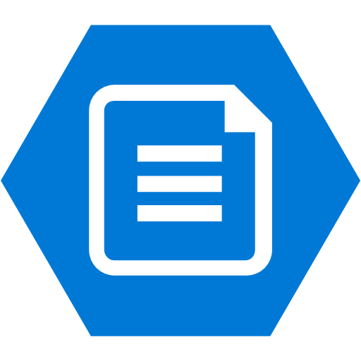
Documentum Migration
Chevron, one of the world’s largest oil and gas companies, chose Azure Database for PostgreSQL to replace Oracle in its 12 Documentum environments worldwide.
Migration to Azure Database for PostgreSQL
Documentum is a critical application for engineering and operational workflows at Chevron, storing important information including oilfield maps and engineering drawings
When OpenText decided to move their Documentum content management platform away from Oracle to optimize on PostgreSQL, Chevron turned to Azure.
Thanks to a strong partnership across Microsoft, OpenText, and Chevron, they successfully deployed the OpenText solution on Azure Database for PostgreSQL and migrated the data from on-premises Oracle to Azure
Chevron has migrated 12 instances across the globe to Azure Database for PostgreSQL
CI
Hub Vnet
Spoke Vnet
User Access
CD
Azure DevOps
Node 1
Node 2
Node 3
ExpressRoute
Azure Database for PostgreSQL
Azure Files
On-Prem

Slide 13

Cloud-native applications
Cloud-native applications
Transactional applications
Geospatial aware applications
SaaS
applications

Slide 14

Transactional applications

Slide 15
Transactional applications
Why use Azure Database for PostgreSQL for transactional apps?
Robust support for many data types, including time-series data and semi-structured data with JSONB
Postgres transactions are ACID (Atomicity, Consistency, Isolation, and Durability) compliant, ensuring strong consistency for apps that must be always up to date
Benefit from cloud scale, built-in intelligence, advanced security and compliance, high availability, and integration with the Azure ecosystem

Slide 16







Banking Platform
“The availability of open-source services on Azure enabled Finxact to leverage the most advanced solutions to support our customers’ business needs at massive scale.”
– Frank Sanchez, CEO, Finxact
INTERNET
Azure DNS
Building a cloud-native banking platform
Finxact provides banks with a modern approach to their system of record – the core services that handle deposits, loans, and other banking functions.
Their cloud-native architecture ensures they can meet the demands of modern banks – massive scale, performance, high availability, and ability to meet regulatory requirements.
Finxact leverages managed open-source services, including Azure Kubernetes Service and Azure Database for PostgreSQL.
Benefits of Azure Database for PostgreSQL
Azure Database for PostgreSQL is used as a relational data store for Finxact’s core processing service.
They leverage JSON data types, thanks to Postgres’ support for JSONB, enabling a flexible data model.
Service availability is crucial. Azure Database for PostgreSQL is backed by a 99.99% SLA, but Finxact also deploys their database across multiple Availability Zones to provide an even higher level of availability.
Azure Public Load Balancer
Azure Public Load Balancer
Public Subnet xxxxx/xx
Public Subnet xxxxx/xx
Bastion Host
Bastion Host
Bastion Host
Bastion Host
Bastion Host
Bastion Host
Public Subnet xxxxx/xx
Public Subnet xxxxx/xx
Namespace 1-n
Namespace 1-n
Namespace 1-n
Namespace 1-n
Namespace 1-n
Namespace 1-n
AKS
AKS
Availability Zone 1
Availability Zone 2
Availability Zone 3
Availability Zone 1
Availability Zone 2
Availability Zone 3
Azure files
Replica
Azure files
Customer 1
Customer 1
Public Subnet xxxxx/xx
Public Subnet xxxxx/xx
Azure Database for PostgreSQL OLAP
Azure Database for PostgreSQL OLAP
Azure Bob Storage
Replica
Azure Database for PostgreSQL OLAP
Azure Database for PostgreSQL OLAP
Azure Bob Storage
Customer n
Customer n
Public Subnet xxxxx/xx
Replica
Public Subnet xxxxx/xx
Azure Database for PostgreSQL OLAP
Azure Database for PostgreSQL OLAP
Azure Bob Storage
Azure Database for PostgreSQL OLAP
Azure Database for PostgreSQL OLAP
Azure Bob Storage
Read the case study

Slide 17

Connected Vehicle Backend
Postgres powers connected passenger cars
Car manufacturer had monolithic existing system to power their connected vehicle services. Oracle history and open source preference led them to choose PostgreSQL as they moved to the cloud.
Modernized by replacing their old system with a cloud-native, microservices based system powered by Azure Database for PostgreSQL and Azure Kubernetes Service.
Hundreds of AKS clusters power dozens of applications users interact with in passenger cars, including navigation, entertainment, and a virtual assistant.
Postgres stores almost all backend data. For example, Postgres databases store the mapping of which customers have subscribed to each service offered by the platform - a cornerstone of the overall system.
Azure Database for PostgreSQL provides advanced security for sensitive data, high availability for mission-critical services, and cloud scale.
Azure
Kubernetes Service
Azure
Kubernetes Service
Azure
Kubernetes Service
Azure
Kubernetes Service
Azure
Kubernetes Service
Azure
Kubernetes Service
Azure
Kubernetes Service
Azure
Kubernetes Service
Azure
Kubernetes Service
Azure
Kubernetes Service

Slide 18








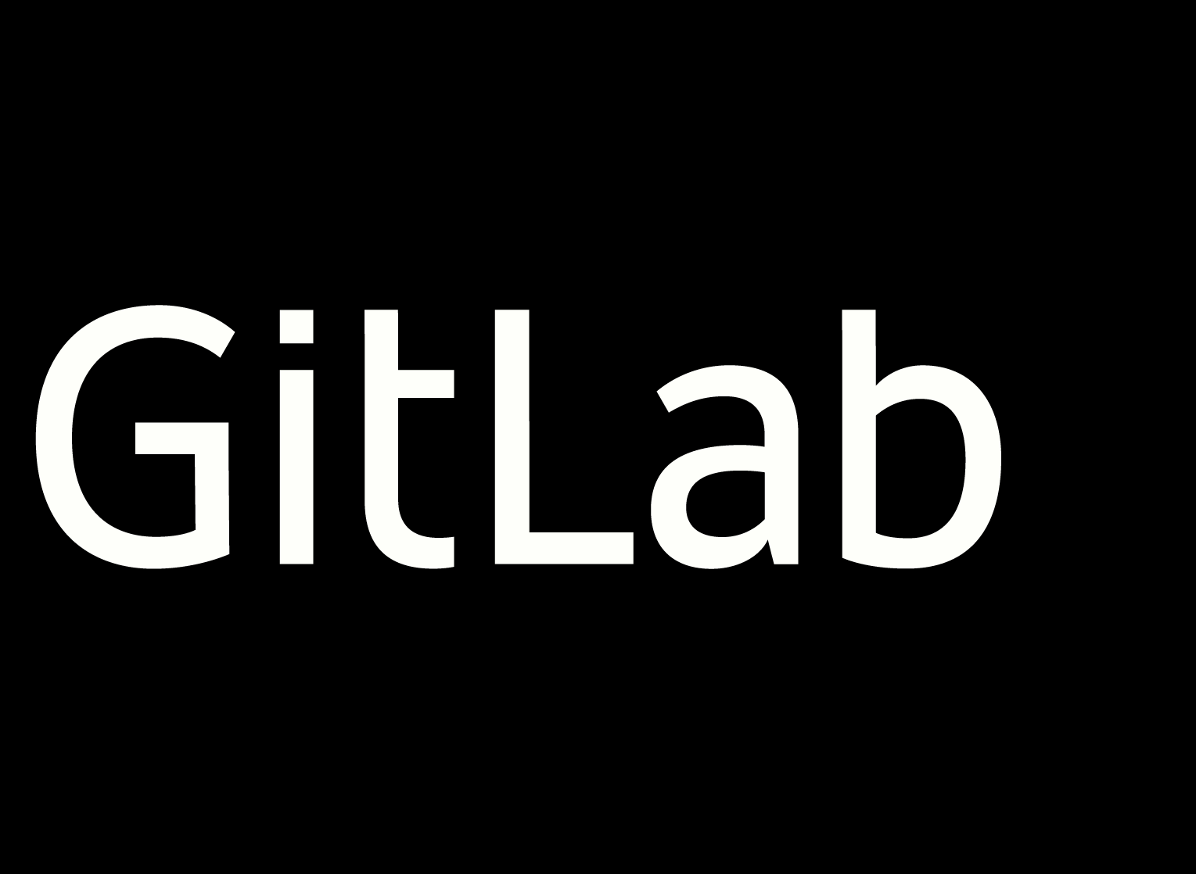







Vehicle Safety App
Robert Bosch GmbH is an engineering and technology company which creates products and services across Mobility Solutions, Industrial Technology, Consumer Goods, and Energy and Building Technology. With the goal of saving lives, Bosch turned to Azure to help build a wrong-way driver warning service.
Keeping drivers safe using data
As they set out to solve the problem of drivers going the wrong way on highways, Bosch knew they could not compromise when it came to real-time speed and precision of location data.
Bosch built a solution using Azure managed services, including Azure Database for PostgreSQL, Azure Kubernetes Service, Azure Cache for Redis, Azure Databricks, and more. Leveraging PaaS services freed Bosch’s small development team from time spent managing infrastructure.
Building a cloud-native application
Azure Database for PostgreSQL delivers a highly available relational database that requires almost no administration, saving them time and costs.
Azure Database for PostgreSQL seamlessly integrates with services like Azure Kubernetes Service and Azure Databricks.
The solution ingests 6M requests per day from devices emitting GPS data and from partner systems.
By running on Azure, Bosch improved the average time to calculate whether a driver is going the wrong way to 60 milliseconds.
Wrong-way driver warning services
Azure AD authentication
Virtual API
Management
Virtual
Key Vault
Azure App
for Containers
Azure App Service
Virtual network
security
Azure Container
Registry
Push servicer
Azure
Kubernetes Service
Kafka on
Azure HDInsights
Continuous Map updates
Azure
Data Explorer
Azure
Monitor
Azure
Cache for Redis
Azure Database
for PostgreSQL
Azure
Databricks
Read the case study

Slide 19

Retail Store App
Build apps to facilitate retail transactions
Azure Database for PostgreSQL is often used in retail applications; for example, storing point of sale data, facilitating e-commerce transactions, or powering inventory management systems.
Here, a large grocery chain uses Azure Database for PostgreSQL for an app that distributes data on prices, promotions and product images to checkout tills in around 4,000 stores.
Updates happen in near real time, and cannot have a high impact on the network, as the network is used for many different purposes, including card payments.
There must be consistency across stores even while updates are being made centrally to prices in the PostgreSQL database. A mechanism similar to Kafka offsets was used to achieve consistency, and PostgreSQL was selected as it supports this. The current offset is a pointer to the last record sent to the device in the most recent poll. In-store devices poll APIs for updates using offsets. Updates up to a maximum offset are sent to a server in each store which, in turn, distributes the updates to tills.
Updates to price and product data are published to a HTTP endpoint. The data is inserted into the PostgreSQL database, with an offset assigned.
Tills connect to a server in each store
On-Premises
API Management Services
Application Gateway
Azure
Kubernetes Service
Azure Database
for PostgreSQL

Slide 20






Java App Modernization
Swiss Re, one of the world’s largest reinsurers, uses Azure PaaS services, including Azure Database for PostgreSQL, to power a digital transformation that includes the modernization of business-critical financial systems.
Simplifying development with Azure
Swiss Re has built new Java-based financial apps and migrated existing ones using Azure Spring Cloud, a fully managed infrastructure for Spring Boot applications.
Azure supports the company’s strict security and regulatory requirements, and allows developers to develop and deploy solutions faster.
The team can store and retrieve information in Azure Database for PostgreSQL with a simple Spring Data JDBC call.
For persistency, any data managed in their microservices is stored in PostgreSQL.
Azure Database for PostgreSQL and Azure Spring Cloud enable Swiss Re’s developers to focus on writing apps, while Azure takes care of scaling, security, compliance, and high availability.
Azure
Azure Spring Cloud
Business User
Spring Cloud Gateway
Spring Boot
Azure Storage
Static Content
Azure Monitor
Applications Insights
Log Analysis
Workspace
Cloud fair
Gateway
Back in Servers
Spring Boot
Azure AD
Tenant
Azure Database for PostgreSQL
Database
Azure Key Vault
Key Vault
Read the case study

Slide 21
Geospatial aware applications

Slide 22
Geospatial aware applications
Why use Azure Database for PostgreSQL for geospatial aware apps?
Azure Database for PostgreSQL is often used for apps with a location component – for example, route optimization, fleet monitoring, and supply chain management
Robust support for many data types, including time-series data, JSONB, and geospatial data with PostGIS
Postgres transactions are ACID (Atomicity, Consistency, Isolation, and Durability) compliant, ensuring strong consistency for apps that must be always up to date
Benefit from cloud scale, built-in intelligence, advanced security and compliance, high availability, and integration with the Azure ecosystem

Slide 23


Package Tracking
Efficiently track packages and deliveries at scale
Event-driven architecture using Azure Event Hubs collects tracking data and distributes it to business intelligence systems that power reporting.
Microservices running on Azure Kubernetes Service grab tracking data from Event Hubs and perform calculations – for example, package lifecycle.
With PostgreSQL’s JSONB support, data and logic can be stored in the same document. Calculations like package lifecycle don’t have to be made every time the package is scanned, and less data is stored and archived, lowering storage costs.
Azure Database for PostgreSQL provides scale, high availability, and rich support for geospatial data with the PostGIS extension.
Azure Kubernetes Service
Legacy central database
Event ingestion
Parcel
Processing
Parcel Master
Processing
Azure
ExpressRoute
Master data ingestion
Event store maintenance
Azure
Load Balancer
Scan Server
Azure Database
for PostgreSQL
Azure Event
Hub
On-premises

Slide 24
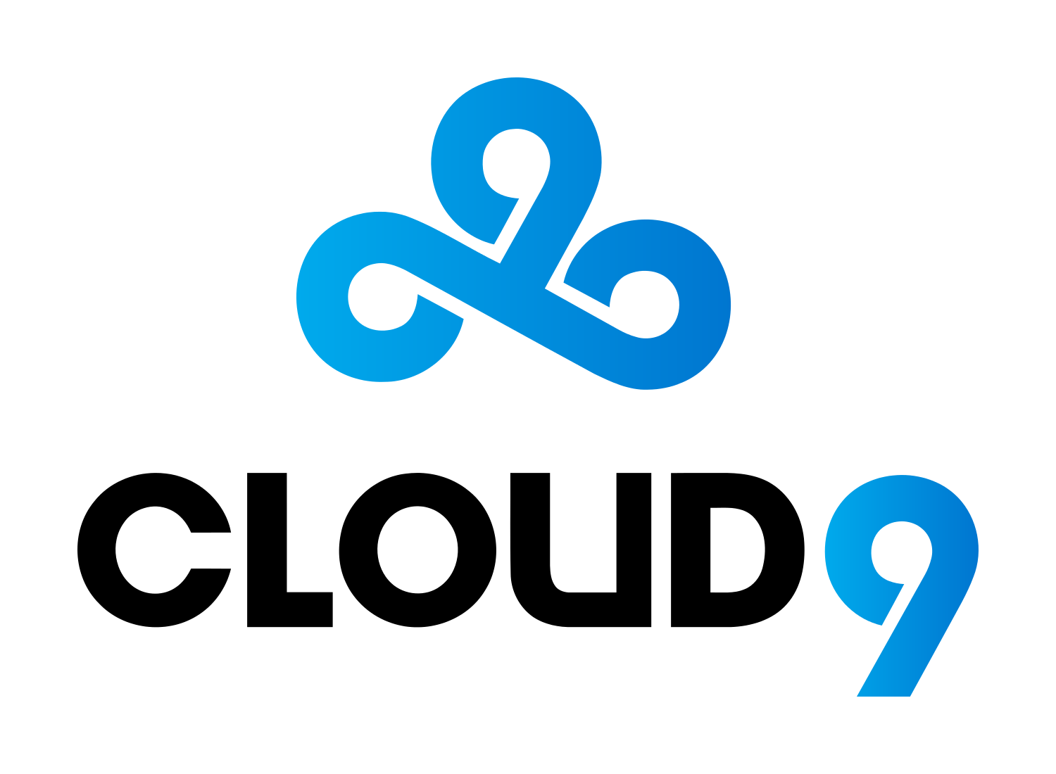



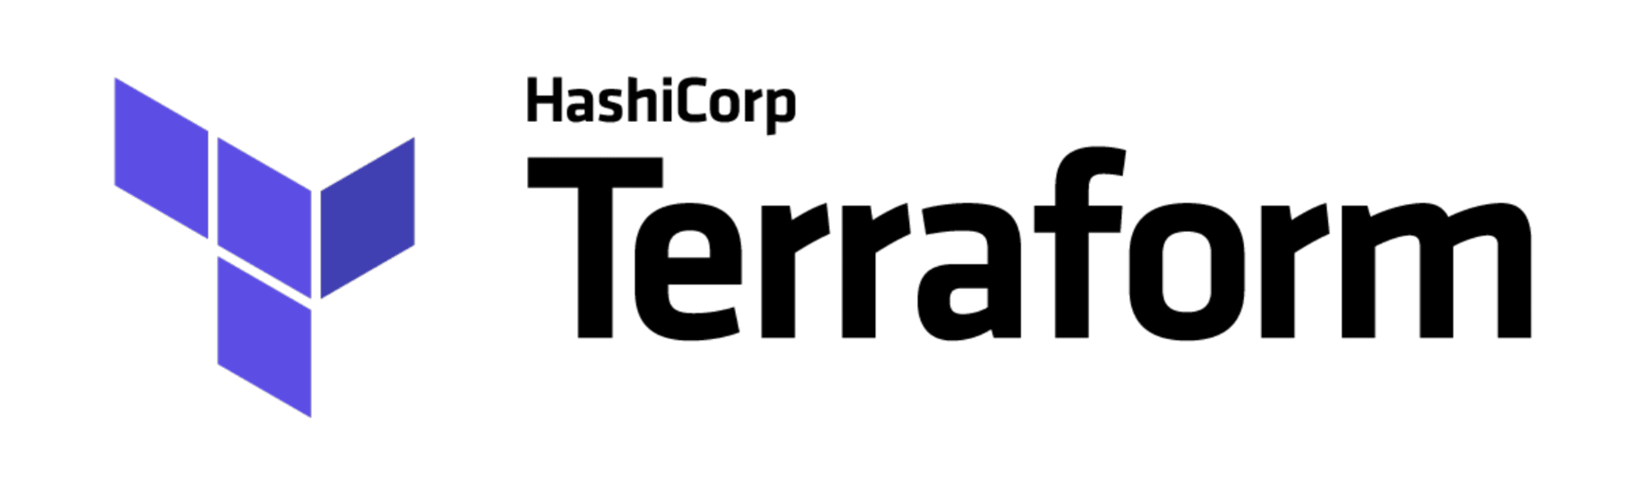
Gaming Insights Platform
“We started by asking, what is the most important data we can act on that is not otherwise available to us? Then we built a pipeline on Azure to automate the process of finding it, capturing it, and making it usable.”
– Mike Downey, Director of Sports Technology, Cloud9
Cloud9, a top esports competitor, relies on data and analytics to inform the way their players train, strategize, and compete. Their Game Insights Platform, built on Azure, is a great example for companies across industries seeking to harness data for business intelligence. case study here
Data as a competitive advantage
Using Azure, Cloud9 built a real-time dashboard to help coaches and players track wins, strategies, matches, and trends over time.
Cloud9 chose Azure Database for PostgreSQL as the primary database to store positional information because of PostgreSQL’s rich geolocation analysis features.
A machine learning model analyzes videos of gameplay and identifies interesting parts, storing the output in Azure Database for PostgreSQL.
By using a fully managed Postgres service, Cloud9 gains intelligent performance, security, and scalability without having to manage the database themselves.
Azure Database for PostgreSQL seamlessly integrates with services like Azure Functions and Power BI.
Azure
Producers
Ingestion
Event processing
Storage
Containers
Azure Queue
Storage
Azure
Functions
Azure Database for PostgreSQL
Microsoft Power BI
Game data
Azure Blob Storage
Azure Container Instances
Azure Blob Storage
Docker Push
Docker Pull
Computer Vision
Azure Pipelines
Azure
Container Registry
Azure Monitor
Azure Key Vault
Read the case study and watch the video to learn more

Slide 25
SaaS applications

Slide 26
SaaS applications
Why use Azure Database for PostgreSQL for geospatial aware apps?
Multi-tenant architecture often with one database server per customer
JSONB support makes it possible to combine relational data with semi-structured data types.
Read replicas can help improve performance and scale of read-intensive workloads
Benefit from cloud scale, built-in intelligence, advanced security and compliance, high availability, and integration with the Azure ecosystem.

Slide 27


Sales and Marketing Automation
Build scalable, multi-tenant sales and marketing platforms
Common solutions include email marketing and ecommerce platforms
Multi-tenant architecture often with one database server per customer
Easily scale during peak times (e.g. holiday season)
PostgreSQL’s extensibility and support for many types of data (e.g. JSONB, time-series) make it a flexible choice
Azure Database for PostgreSQL provides reliability, high availability, and performance necessary to meet customer expectations
Read replicas can help improve performance and scale of read-intensive workloads e.g. BI workloads for reporting
Core Resource Group
VNET Peering Connection
Backing Services Resource Group
Applications
Cloud Controller
Private servers
Service Manager
Service Broker
ResourceManager,
Database
Applications

Slide 28








IoT Development Platform
PTC creates digital solutions for Industrial IoT that help manufacturing, service, and engineering companies connect, monitor, analyze, and act on data in new ways.
Industrial IoT Platform
PTC’s ThingWorx solution is an Industrial IoT platform with tools to help businesses connect assets, build apps and augmented reality experiences, analyze IoT data, manage connected systems, and more.
Common use cases include remote asset monitoring, predictive maintenance, remote service, and equipment optimization.
Architecture and database
Thingworx is a multi-tenant SaaS app. A distributed architecture allows for global management of consolidated statistics and KPIs, while local managers get focused, real-time information on their specific locations.
PTC customers can choose their preferred database, and Azure Database for PostgreSQL is a popular choice. High availability, security, and performance are key requirements in the Industrial IoT space.
Virtual Network
Experience Repository
Experience
Repository
Azure Database for PostgreSQL

Slide 29


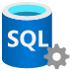
Car Rental App
Azure
VNet
InternetZone
Microsoft KeyVault
ServiceEndpoint
Global customer-facing web app
App helps customers book car rentals – choose car, schedule and manage rentals.
Java web app (Spring Boot) uses Azure Database for PostgreSQL Single Server and Azure Kubernetes Service.
App will have multi-tenant architecture as car rental service expands globally, with regional deployments.
Azure Database for PostgreSQL chosen due to existing Postgres skillset and open source preference, in addition to PaaS benefits like high availability.
Security is a top priority as the app handles confidential data, such as PII and internal business data. Customer managed key encryption was a requirement.
Azure Kubernetes Service
Azure Load Balancer
Microsoft SQL
ServiceEndpoint
InternetZone
Container Registry
VNet
InternetZone
Microsoft KeyVault
ServiceEndpoint
Azure Load Balancer
Azure Kubernetes Service
Microsoft SQL
ServiceEndpoint
Container Registry
Corporate network, Data center
External access
Other external data centers

Slide 30
Microsoft

